Slide 1

Department of Computer Science & Engineering
Acharya Institute of Technology
Soladevanahalli, Bengaluru 560 107
Project Phase 1 Synopsis Presentation on
“ AI-Based Delay Prediction and Transparency System for Public Project Management(Nirmaan.ai)”
Presented by
Group No | Name | USN
49 | BASANAGOUDA METI | 1AY22CS040
 | CHANDRASHEKARA SHIVACHARYA V M | 1AY23CS402
 | CHINMAY K G | 1AY22CS050
 | ADITYA S G | 1AY22CS013
Guide Name: Prof. SUPREETHA H H Designation: Assistant Professor , Dept of CS&E
Dept of CSE

Slide 2
AI-Based Delay Prediction and Transparency System for Public Project Management (Nirmaan.ai)
1. Introduction
2. Literature Survey
3. Problem statement and Objectives
4. Proposed Methodology
5. Deliverables
6. Individual Responsibilities among the group members
7. Gantt Chart
8. References
Dept of CSE

Slide 3
1. INTRODUCTION
Public projects in India often face delays, overruns and opacity
Nirmaan.ai provides transparent monitoring with role-based access
ML-driven delay prediction + real-time dashboards + citizen feedback
Dept of CSE

Slide 4
2. LITERATURE SURVEY
S.N | Paper title | Publication details | Name of the Authors | Technical Ideas / Algorithms discussed in the paper | Shortfalls and solution provided in the proposed methodology
1 | "Smart Infrastructure Monitoring using IoT and ML" | IEEE Xplore, 2020 | Rahul Kumar, Sneha Jain | IoT sensors for realtime data, ML-based risk analysis | Lacks public transparency - Does not involve citizen engagement
2 | - Lacks public transparency - Does not involve citizen engagement | IJERT, 2019 | A. Dey, S. Raut, K. Mehta | GPS-based geo-tagging and project updates via a web dashboard | Limited to private projects - No rolebased access or ML predictions
3 | "Predicting Delays in Public Infrastructure Projects using ML" | Springer, 2021 | K. Bansal, L. Sharma | ML algorithms (Random Forest, SVM) for delay prediction based on past data | - No live project integration - Data not visualized for stakeholders
Dept of CSE

Slide 5
3. PROBLEM STATEMENT & OBJECTIVES
Problem Statement:
Delays, budget overruns, poor monitoring and limited transparency
Lack of real-time oversight and public engagement
Objectives:
Real-time tracking and geo-tagged map views
ML-based delay risk prediction (≥85% accuracy on train set)
Role-based dashboards (admin/official/citizen)
Public transparency and feedback
Centralized reporting and secure JWT auth
Dept of CSE

Slide 6
4. PROPOSED METHODOLOGY
Project data input, geo-tagging and dashboards.
Python ML model (timeline, progress, budget) served via API
Real-time updates; status indicators (on-track, delayed, completed)
RBAC: Admin (create), Official (update), Citizen (view/flag)
Visualization: map + filters; logs and trend graphs
Dept of CSE

Slide 7

5. DELIVERABLES
Deliverables:
  Role-based dashboards + secure login.
  Interactive project map and logs.
  Delay prediction API + results
  Citizen issue reporting
  Use cases: official updates; citizen verification
Dept of CSE

Slide 8

6. GROUP MEMBERS INDIVIDUAL RESPONSIBLITIES
Team Roles for AI-Based Delay Prediction and Transparency System for Public Project Management (Nirmaan.ai)
🔹 Basangouda meti - Data/ML: model training & API
🔹 C S Shivacharya - Frontend: dashboards, map, UX
🔹 Aditya S G - Backend: auth, projects, comments
🔹 Chinmay K G - Docs & testing: reports, PPT, QA
Dept of CSE

Slide 9
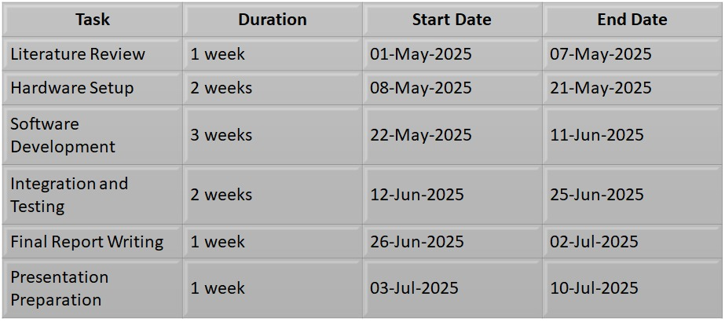
7. GANTT CHART
Dept of CSE

Slide 10

8. REFERENCES
IEEE 2020 (IoT+ML), IJERT 2019 (GPS/Web)
Springer 2021 (ML delays), Elsevier 2022 (Blockchain)
Mapbox, Joblib, JWT, Node/Express docs
Dept of CSE

Slide 11
Demonstration 1
Real-time Project Monitoring:
Uses AI to analyze site images and project data.
Automatically predicts construction stages and potential delays.
Stage Classification:
System classifies projects into 6 distinct stages of construction.
Achieves 85% average prediction confidence.
Project Insights Dashboard:
Centralized view of project details, comments, and AI predictions.
Simplifies project management by consolidating everything in one place.
Improves transparency and accountability across all stakeholders.
Dept of CSE

Slide 12
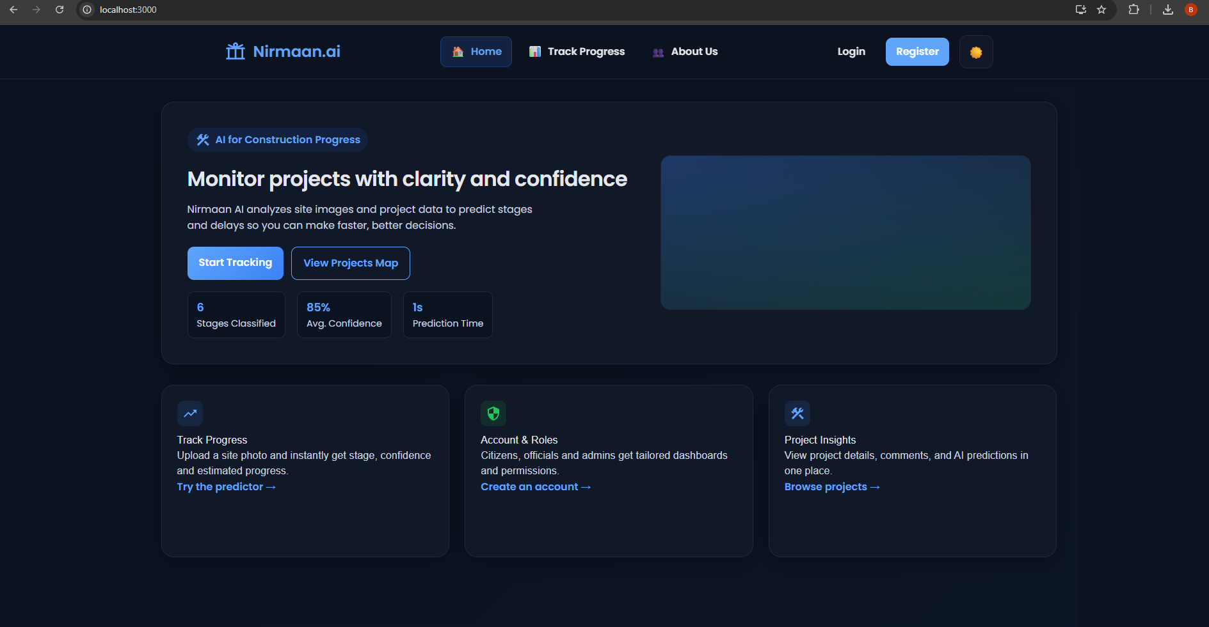
Demonstration 2
Dept of CSE

Slide 13
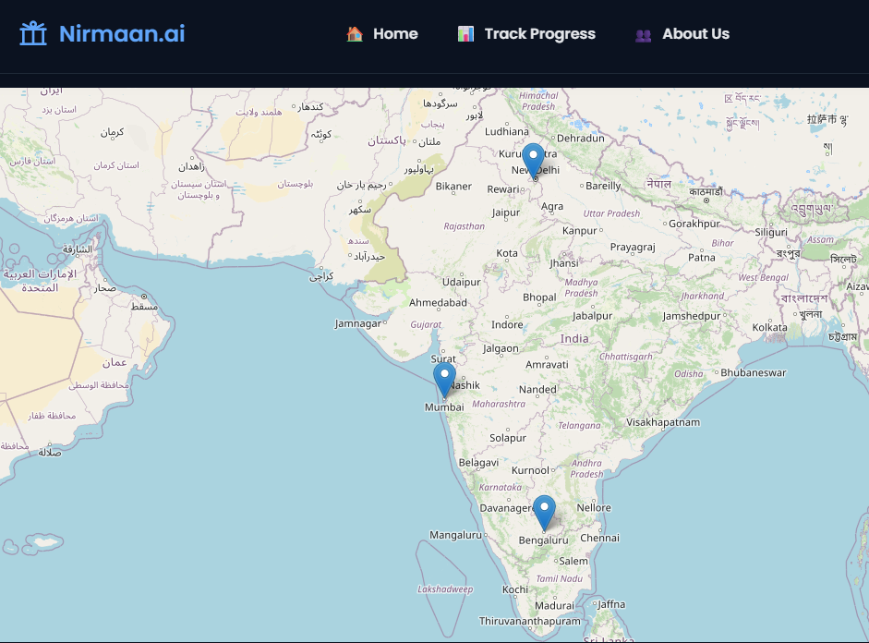
Demonstration 2
Track Progress (AI Predictor):
Users upload a site photo.
AI instantly predicts stage, confidence level, and estimated progress.
Provides real-time updates without manual supervision.
Role-Based Access & Accounts:
Citizens → can track local project progress.
Officials → access detailed dashboards.
Admins → manage roles, permissions, and insights.
Personalized, secure, and role-specific dashboards.
Dept of CSE

